Slide 1


Slide 2
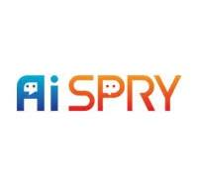
CONTENTS
BUSINESS OBJECTIVE
BUSINESS CONSTRAINTS
PROJECT WORKFLOW
PROJECT ARCHITECTURE
DATA COLLECTION
DATA PREPROCESSING
PROJECT CHALLENGES
CONCLUSION

Slide 3
BUSINESS PROBLEM
The manual monitoring and reporting of safety incidents and compliance issues is inefficient, prone to delays, and inconsistent due to human error. This process can lead to potential safety hazards, regulatory fines, and increased downtime. The current approach relies on employees to report incidents or track compliance manually, which is labor-intensive and creates bottlenecks in maintaining a safe work environment.

Slide 4
OBJECTIVE:
Maximize Workplace Safety, Maximize Hard Detection..
CONSTRAINT:
Minimize cost.

Slide 5
PROJECT WORKFLOW
IMAGE COLLECTION & PREPROCESSING
IMAGE ANNOTATION & DATA AUGMENTATION
OBJECT DETECTION
POSE ESTIMATION
DEPLOYMENT
ANALYSIS & MONITORING

Slide 6
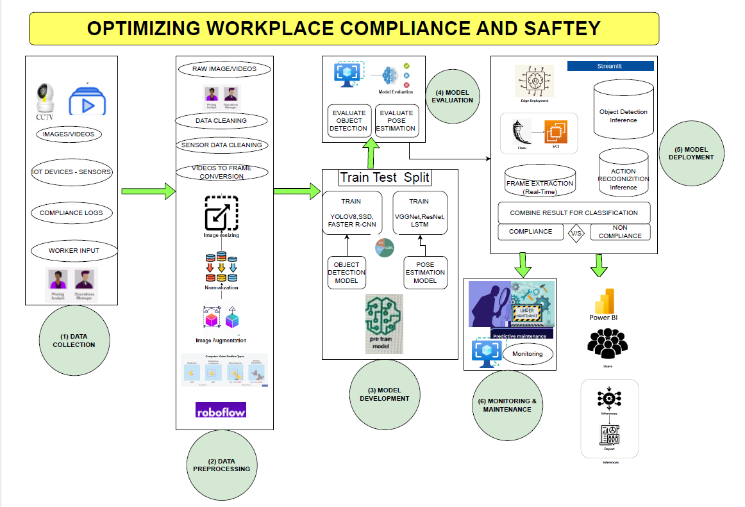
PROJECT ARCHITECTURE-HIGH LEVEL

Slide 7
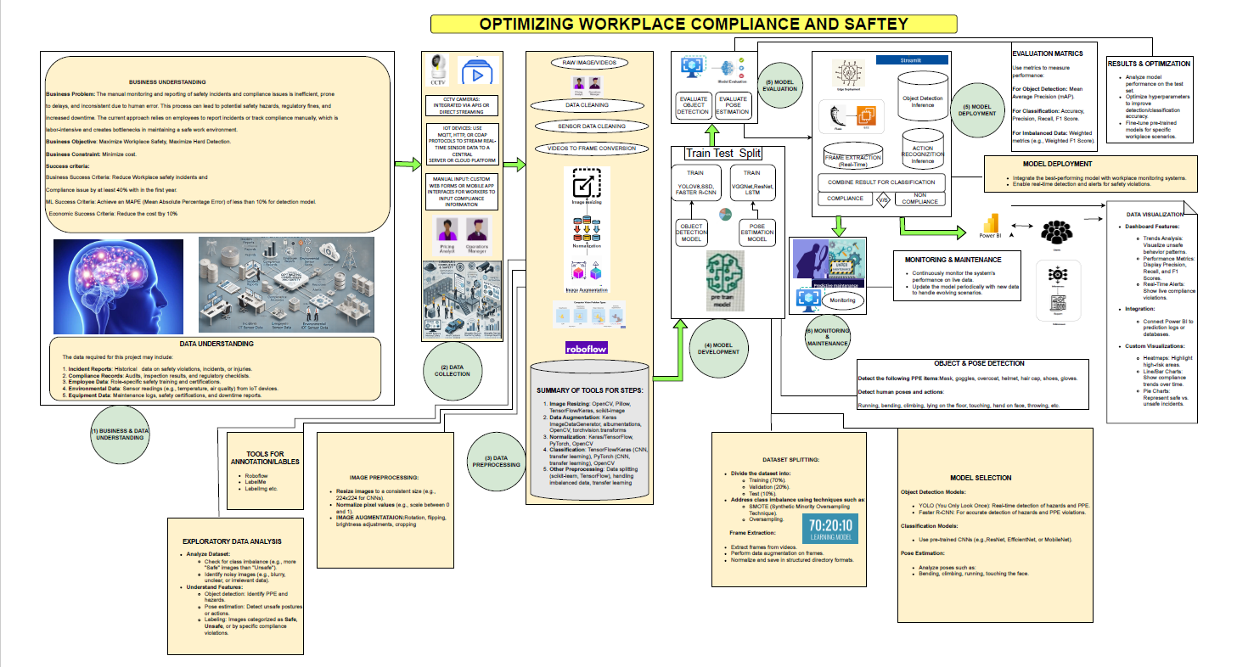
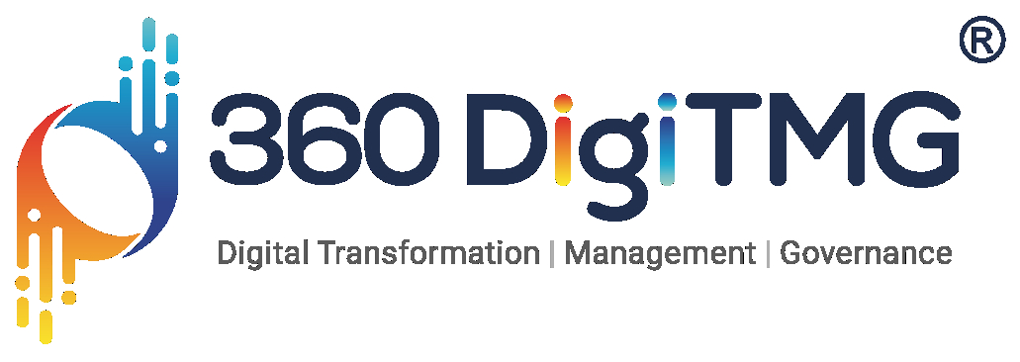
PROJECT ARCHITECTURE-LOW LEVEL

Slide 8
IMAGE COLLECTION & PREPROCESSING:
COLLECTED 540 WORKPLACE SAFETY IMAGES
EXTRACTED IMAGES FROM VIDEOS USING OPENCV.
ANNOTATION WITH ROBOFLOW:
LABELED SAFETY GEAR (GLOVES, MASK, FULL LAB COAT,HALF LABCOAT, SHOES, GOGGLES, HAIR CAP)
COMPLIANCE = ALL REQUIRED SAFETY GEAR DETECTED

Slide 9
DATA AUGMENTATION
TECHNIQUES USED:
  ROTATION, SCALING, FLIPPING
  BRIGHTNESS/CONTRAST ADJUSTMENT
  ADDING NOISE, SHEAR TRANSFORMATION
EACH IMAGE AUGMENTED 3 TIMES TO IMPROVE MODEL PERFORMANCE
OBJECT DETECTION WITH YOLOV11N, YOLOv8n, YOLOv8m, YOLOv8L
WHY YOLO?
  HIGH EFFICIENCY & REAL-TIME DETECTION
  IMPROVED FEATURE EXTRACTION
MODEL TRAINING:
  EPOCHS: 50
  IMAGE SIZE: 640PX
  PERFORMANCE METRICS: LOSS, MAP

Slide 10
POSE ESTIMATION WITH YOLOV11N
INSTALLED DEPENDENCIES FOR POSE ESTIMATION
ACTION FOR POSE ESTIMATION (BENDING,JUMPING,RUNNING, LAYING ON FLOOR,FACE TOUCHING,ARM RAISING)
USED YOLOV11N-POSE MODEL
EVALUATED WORKER POSTURE & ACTIVITY COMPLIANCE
DEPLOYMENT WITH STREAMLIT
WHY STREAMLIT?
  LIGHTWEIGHT & INTERACTIVE WEB-BASED UI
FEATURES IMPLEMENTED:
  UPLOAD IMAGES (JPG, PNG)
  REAL-TIME OBJECT DETECTION & POSE ESTIMATION
  COMPLIANCE STATUS DISPLAY

Slide 11
CONCLUSION
SUCCESSFULLY IMPLEMENTED AI-POWERED COMPLIANCE MONITORING.
AUTOMATED REAL-TIME SAFETY TRACKING
DEPLOYMENT ENABLES EASY WORKPLACE MONITORING

Slide 12
PROJECT
CHALLENGES

Slide 13
1. DATA COLLECTION CHALLENGES
LIMITED DATASET: COLLECTING ENOUGH HIGH-QUALITY WORKPLACE IMAGES CAN BE DIFFICULT.
DIVERSITY OF WORK ENVIRONMENTS: DIFFERENT WORKPLACES HAVE VARYING LIGHTING CONDITIONS, ANGLES, AND SAFETY PROTOCOLS.
VIDEO FRAME EXTRACTION ISSUES: EXTRACTING MEANINGFUL FRAMES FROM VIDEOS WHILE AVOIDING REDUNDANCY OR BLURRINESS.

Slide 14
2. ANNOTATION AND LABELING CHALLENGES
MANUAL EFFORT: ANNOTATING IMAGES IN ROBOFLOW IS TIME-CONSUMING.
CLASS IMBALANCE:
SOME SAFETY GEAR ITEMS (E.G., GLOVES, GOGGLES) MIGHT APPEAR LESS FREQUENTLY, LEADING TO BIASED MODEL PERFORMANCE.
COMPLEX SCENES:
MULTIPLE WORKERS AND OVERLAPPING OBJECTS CAN MAKE ANNOTATION DIFFICULT

Slide 15
3.MODEL TRAINING CHALLENGES
COMPUTATIONAL REQUIREMENTS: TRAINING YOLOV11N REQUIRES HIGH GPU RESOURCES, WHICH MAY BE COSTLY.
HYPERPARAMETER TUNING: FINDING THE BEST LEARNING RATE, BATCH SIZE, AND EPOCH COUNT FOR OPTIMAL PERFORMANCE.
FALSE POSITIVES & FALSE NEGATIVES: MODEL MIGHT DETECT SAFETY GEAR INCORRECTLY, LEADING TO INACCURATE COMPLIANCE REPORTING.

Slide 16
4. POSE ESTIMATION CHALLENGES
OCCLUSIONS: WORKERS’ BODY PARTS MAY BE BLOCKED BY MACHINERY OR OTHER WORKERS.
INCORRECT POSTURE DETECTION: VARIATIONS IN WORKER MOVEMENTS CAN LEAD TO INCORRECT POSE CLASSIFICATION.
MODEL GENERALIZATION: ENSURING THE MODEL WORKS WELL ACROSS DIFFERENT WORKPLACES AND JOB ROLES.

Slide 17
5. DEPLOYMENT CHALLENGES (STREAMLIT)
LATENCY ISSUES: REAL-TIME OBJECT DETECTION MAY SLOW DOWN DUE TO LARGE IMAGE SIZES.
USER-FRIENDLY INTERFACE: ENSURING A SIMPLE AND INTERACTIVE UI FOR NON-TECHNICAL USERS.
INTEGRATION WITH EXISTING SYSTEMS:
MANY COMPANIES HAVE LEGACY SAFETY MONITORING SYSTEMS THAT NEED SEAMLESS INTEGRATION.

Slide 18
6. BUSINESS & ECONOMIC CHALLENGES
ADOPTION RESISTANCE: EMPLOYEES MAY RESIST AI-BASED MONITORING DUE TO PRIVACY CONCERNS.
COST CONSTRAINTS: BALANCING MODEL ACCURACY WHILE KEEPING DEPLOYMENT AND MAINTENANCE COSTS LOW.
REGULATORY COMPLIANCE: ENSURING THAT AI MONITORING ADHERES TO WORKPLACE SAFETY REGULATIONS AND LABOR LAWS.

Slide 19

IF YOU HAVE ANY QUESTIONS OR NEED FURTHER CLARIFICATION, FEEL FREE TO ASK.
PROJECT LEAD: GAYATRI K
PRESENTED BY:MANDEEP SINGH THAKUR

